Slide 1
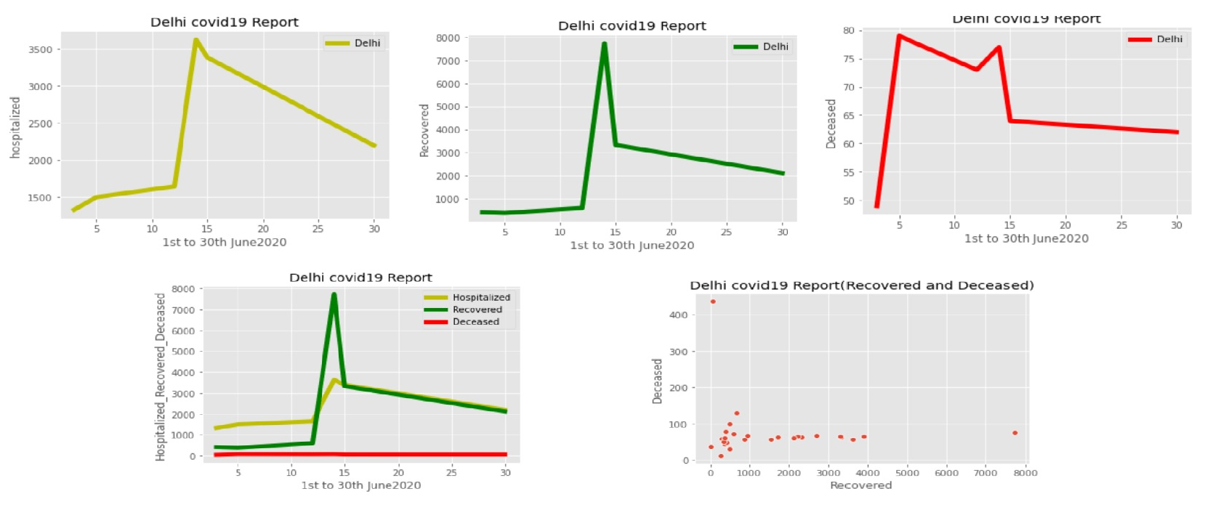
State- Delhi (Covid19 Report)

